Slide 1



Gene2vec : distributed representation of genes based on co-expression
Vasudev R
Empid - 10073
Software developer trainee in machine learning
Machine learning department
feathersoft.com

Slide 2
Agenda for discussion
Machine Learning Algorithms working
Machine learning classification
A simple example
Modelling process in SL
Real world example
Overall Architecture of SL
Deep Learning Algorithms working
What is ANN
What’s Artificial Neuron
How relationship is captured
What’s weight and bias ?
Natural Language Processing
Types of input in NLP tasks ?
Whats RNN ?
Whats word Embeddings in NLP ?
What’s with word2vec
Gene2vec Paper explainaton

Slide 3
Machine Learning algorithms working

Slide 4
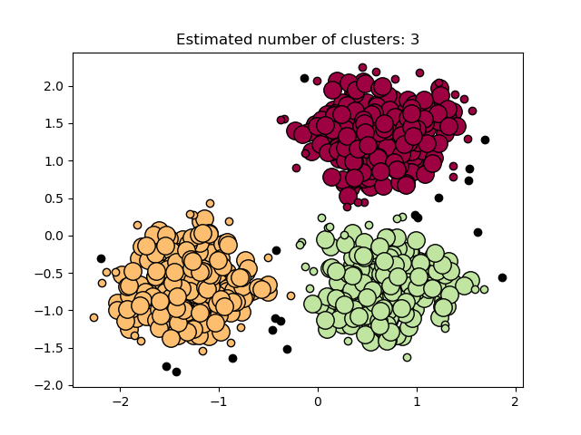
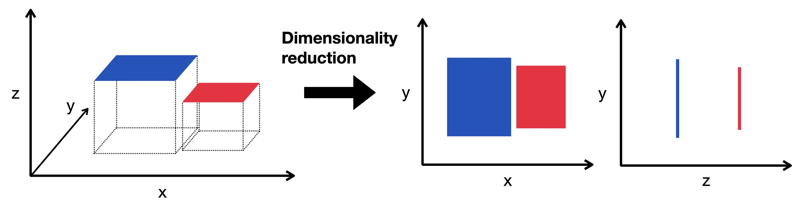
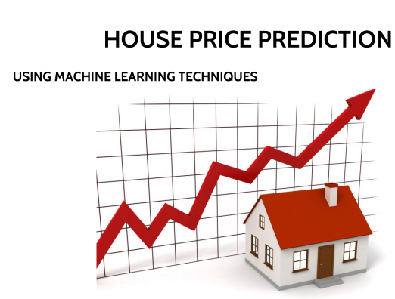
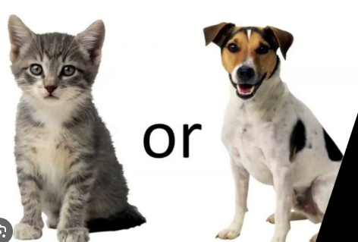
MACHINE LEARNING ALGOS CLASSIFICATION
Machine learning algorithms
Classifications
Supervised learning
Unsupervised learning
Reinforcement learning
Clusturing
Dimensionality reduction
Regression problems
Classification problems

Slide 5
Can you find the values of y for 4 and 5
Input (X) | Output (Y)
1 | 2
2 | 5
3 | 10
4 | ?
5 | ?

Slide 6
Modelled the equation is y = f(x)= x^2 +1
And substituted x with 4 and 5
Input (X) | Output (Y)
1 | 2
2 | 5
3 | 10
4 | 17
5 | 26
Training data
Test data

Slide 7
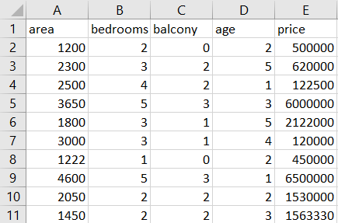
Example Boston House price prediction dataset
Input x1 , x2 , x3 , x4 | Output (Y)

Slide 8
In real life the output and input wont have a perfect relationship
Input (X) | Output (Y)
1 | 2 3
2 | 5 4
3 | 10 11
4
5
It approximates to a function that minimizes the error as small as possible
Here y = f(x)= x^2 +1

Slide 9
Overall Architecture of Supervised Learning Algorithms
Set of inputs
Corresponding output
For each input
Capture the mathematical relationship between them f(x)
that reduces the error
unseen inputs
f(x)
corresponding output

Slide 10
Deep Learning algorithms working

Slide 11
Set of inputs
Corresponding output
For each input
Capture the mathematical relationship between them f(x)
that reduces the error
Model Artificial Neural Network
unseen inputs
f(x)
Model Artificial Neural Network
corresponding output

Slide 12
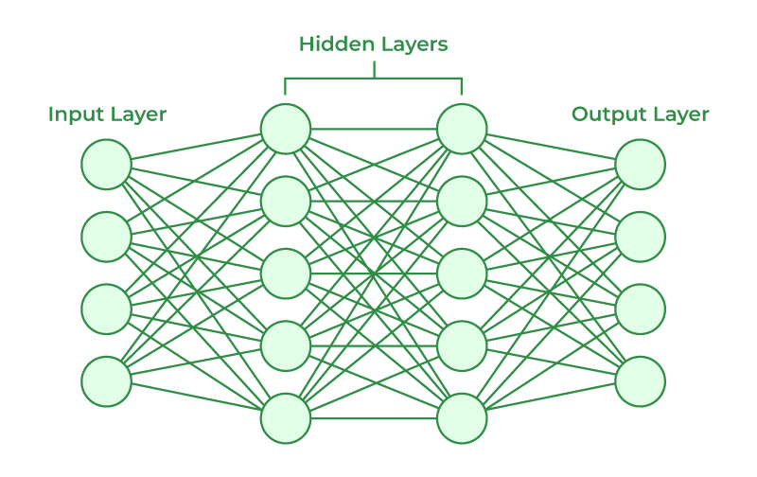
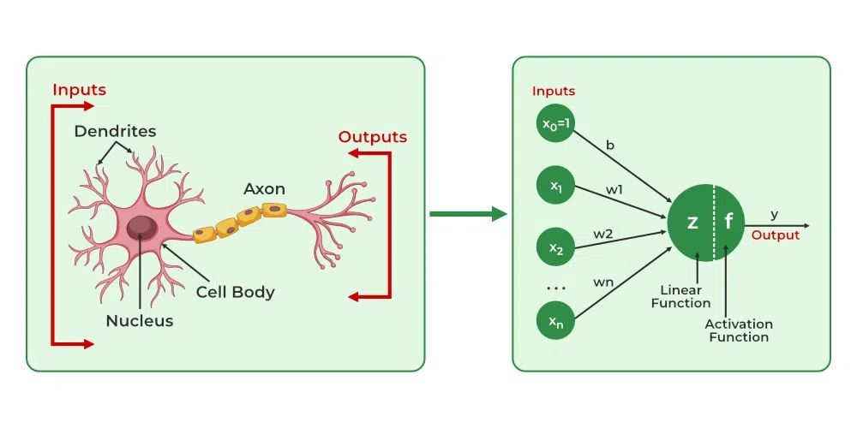
What’s inside an ANN ?
Inside ANN there are many number of neurons
Neurons are inspired by biological neural network
Neurons
Input layer and an activation layer
have weights and bias

Slide 13
How the mathematical relationship is captured ?
Instead of calculating a mathematical function
Based on inputs and their corresponding output labels
Weights and bias values are updated from a small initial value through a process called Backpropagation

Slide 14
Set of inputs
Corresponding output
For each input
Capture the mathematical relationship between them f(x)
that reduces the error
Model Artificial Neural Network
with updated weights and biases
unseen inputs
f(x)
Model Artificial Neural Network
with updated weights and biases
corresponding output

Slide 15
Deep learning algorithms applications
DEEP LEARNING ALGORITHMS
APPLICATIONS
COMPUTER VISION
NATURAL LANGUAGE PROCESSING
Aims to replicate how humans see and understand the world around them.
Facial recognition.
Self-driving cars.
Robotic automation.
Medical anomaly detection.
Sports performance analysis.
Manufacturing fault detection.
Agricultural monitoring.
Plant species classification.
Technology that allows computers to understand, process, and manipulate human language.
Interpret the semantic meaning of language
Translate between human languages
Recognize patterns in human languages
Read text
Hear speech
Measure sentiment
Determine which parts of a text are important

Slide 16
NATURAL LANGUAGE PROCESSING

Slide 17
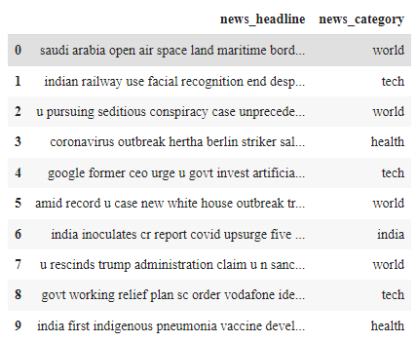
Difference in Input type in NLP vs ML tasks
Input sizes (of sentences) are varying
Sequential Information is also present

Slide 18
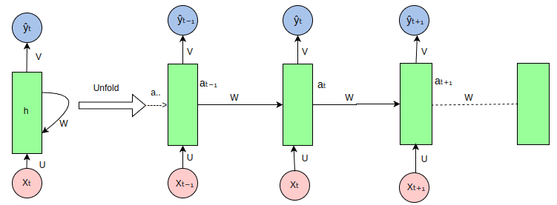
To Resolve this We use RNN (Recurrent Neural Network)
Recurrent means repeating nature
’

Slide 19
E.g. input : Cells are the basic building blocks.
Cells’
RNN
Zero padded vector
Cells

Slide 20
E.g. input : Cells are the basic building blocks.
are’
RNN
Cells’
are

Slide 21
E.g. input : Cells are the basic building blocks.
the’
RNN
are’
the

Slide 22
E.g. input : Cells are the basic building blocks.
basic’
RNN
the’
basic

Slide 23
E.g. input : Cells are the basic building blocks.
building’
RNN
basic’
building

Slide 24
E.g. input : Cells are the basic building blocks.
blocks’
RNN
building’
blocks

Slide 25
E.g. input : Cells are the basic building blocks.
This final output carrys the sequential information of each sentence.
This output is also a fixed size
i.e. for each senteces it gives out fixed size output
Blocks’
RNN
RNN
RNN
RNN
RNN
RNN
Cells
are
the
basic
building
blocks

Slide 26
Overall architecture of RNN + ANN
Cells are the basic building blocks of all living things. The human body is composed of trillions of cells. They provide structure for the body, take in nutrients from food, convert those nutrients into energy, and carry out specialized functions. Cells also contain the body’s hereditary material and can make copies of themselves.
Forward propogation
Cells are the basic building blocks of all living things.
The human body is composed of trillions of cells.
They provide structure for the body, take in nutrients from food, convert those nutrients into energy, and carry out specialized functions.
Cells also contain the body’s hereditary material and can make copies of themselves.
RNN
Test output
For each sentence
backward propogation

Slide 27
Data Preprocessing
The Encoding process
Word Embeddings
Word2vec
Gene2vec

Slide 28
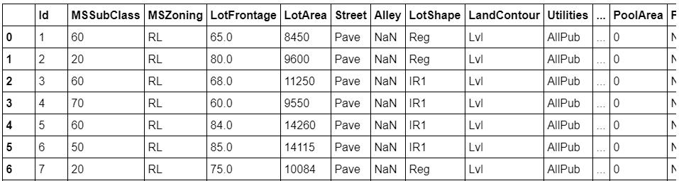
Why Data Preprocessing is needed ?

Slide 29
Some Data Preprocessing techniques
Scaling
Normalization
Filling N/A values
Outlier treatment
Data Encoding
Attribute selection
Dimensionality Reduction
Data Encoding
Common techniques include
One hot encoding
Ordinal encoding
Label Encoding
Target Encoding
Hash Encoding
Categorical Encoding
Categorical Data
Numerical data

